Slide 1




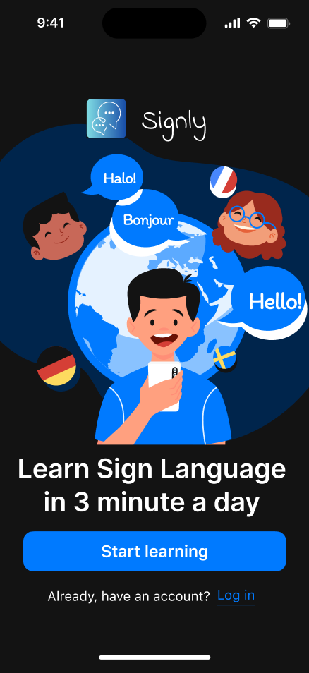

Signly
Learn Sign Language
Let's go

Slide 2


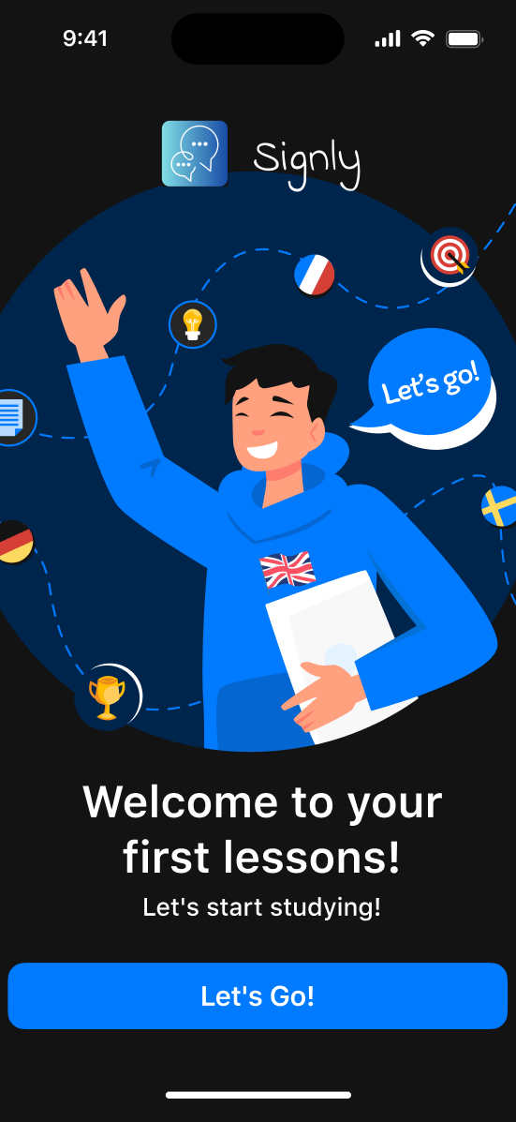
1
Introduction

Slide 3
1
Problem & Motivation
Many individuals struggle understanding accents, different terminology across languages, and masculine/feminine terms
Rare Accessibility for communication with the deaf and hard of hearing
Sign language allows communication across different cultures

Slide 4
2
Application Description
Users are able to learn Sign language Concepts
Multiple Modules/Lessons
Achievements/Progression to bring users back
Target Audience: Young Adults / Adults

Slide 5

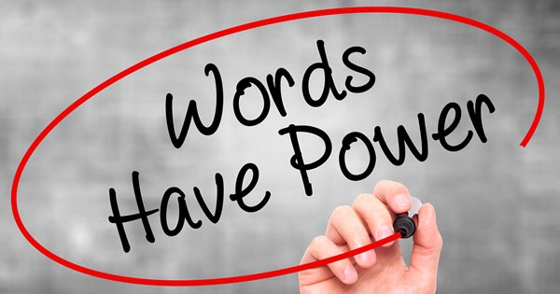
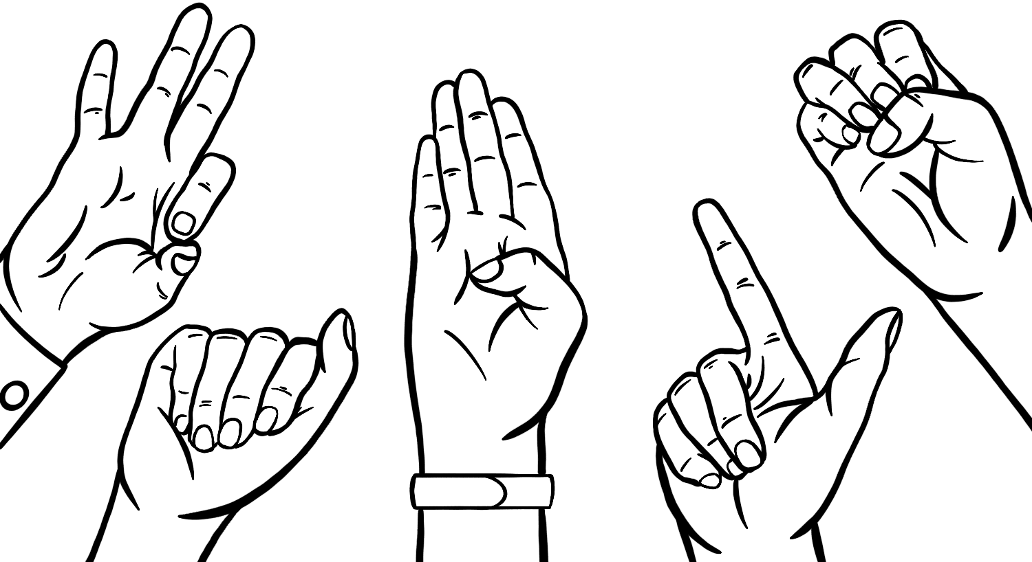
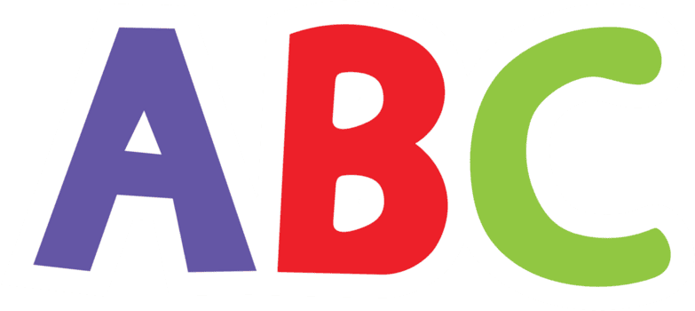
Modules
Module 1: Alphabet
Module 2: Words
Module 3: Sentences
Learn the full alphabet through interactive hand demonstrations, motion guides, and repetition exercises. By the end of this module, users will be able to confidently spell names, places, and simple words using accurate hand shapes and positioning.
Users will learn commonly used words and phrases through guided practice, visual demonstrations, and quick quizzes. This module focuses on recognition, memory retention, and proper hand movement to develop conversational confidence.
Users will learn how to structure sentences, understand grammar rules unique to sign language, and practice real life conversations. This module emphasizes fluency, expression, and comprehension through interactive dialogue scenarios.

Slide 6
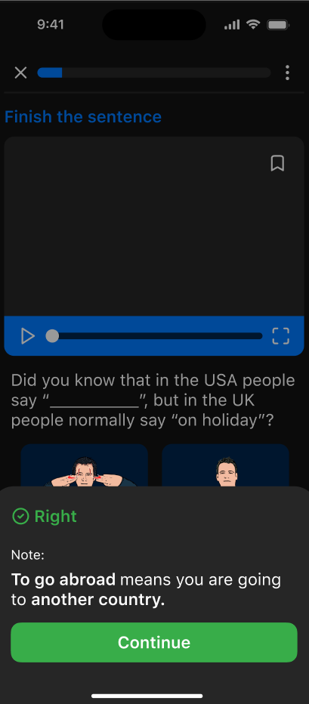
3
How is Signly Unique

Slide 7

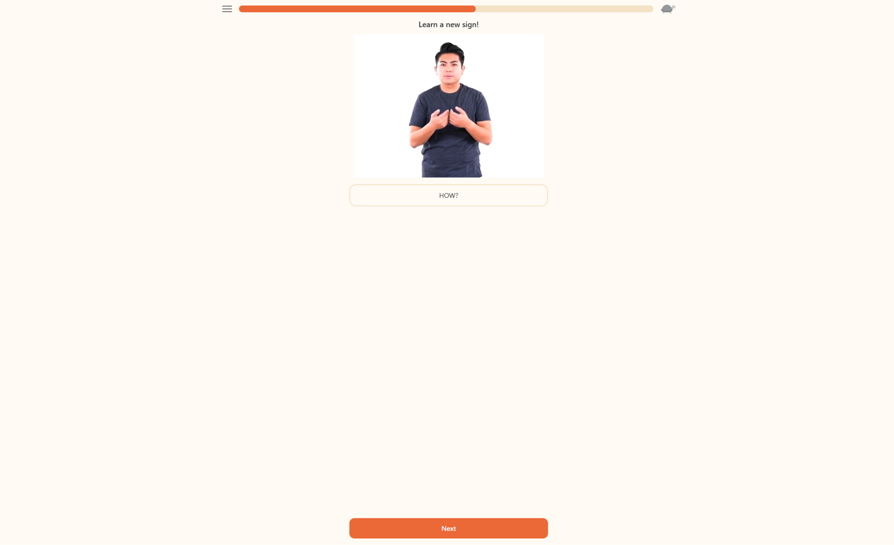
4
Competing Application
Lingvano
Sign Language Web Application
Displays videos with Multiple Choice Questions
Progress through different chapters of learning

Slide 8


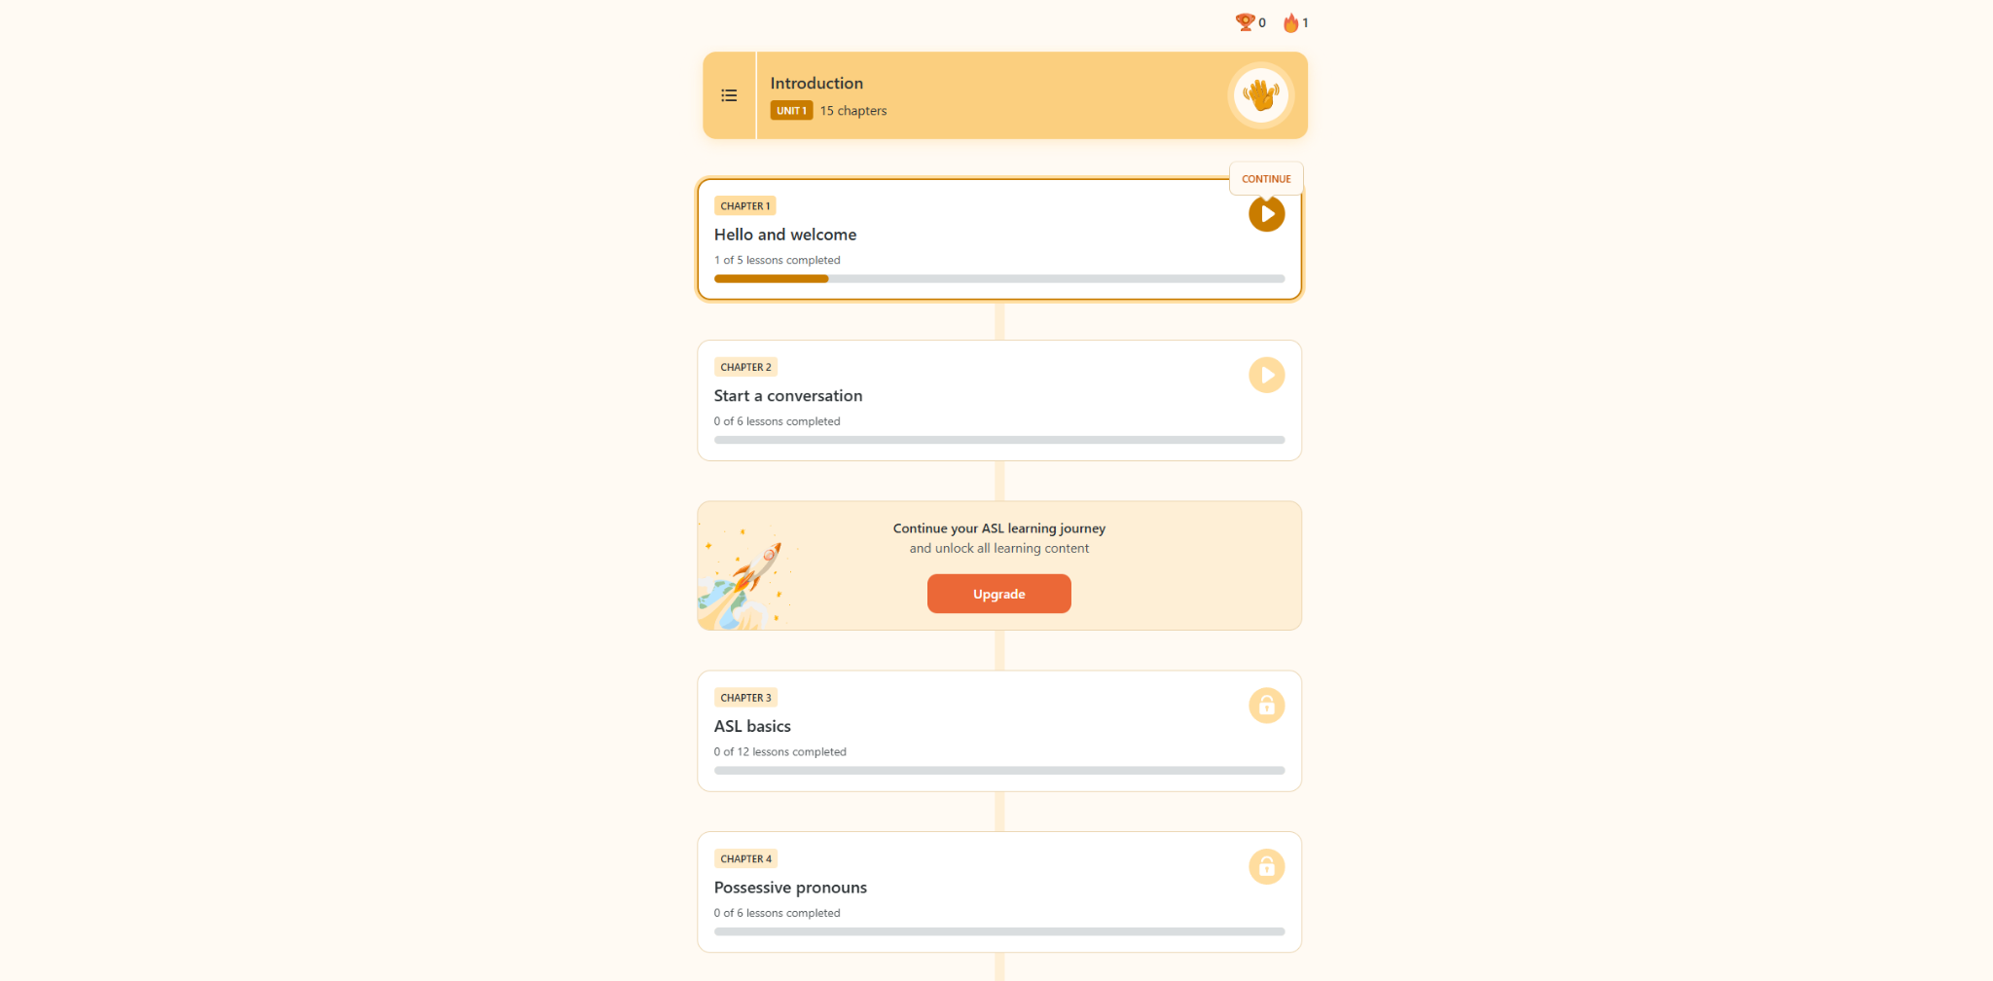
What Problems does Lingvano Have?
1
Simple
Only Quizzes
Progression
Design is minimal
Encourages temporary memorization on topics
Only real progression is streaks

Slide 9

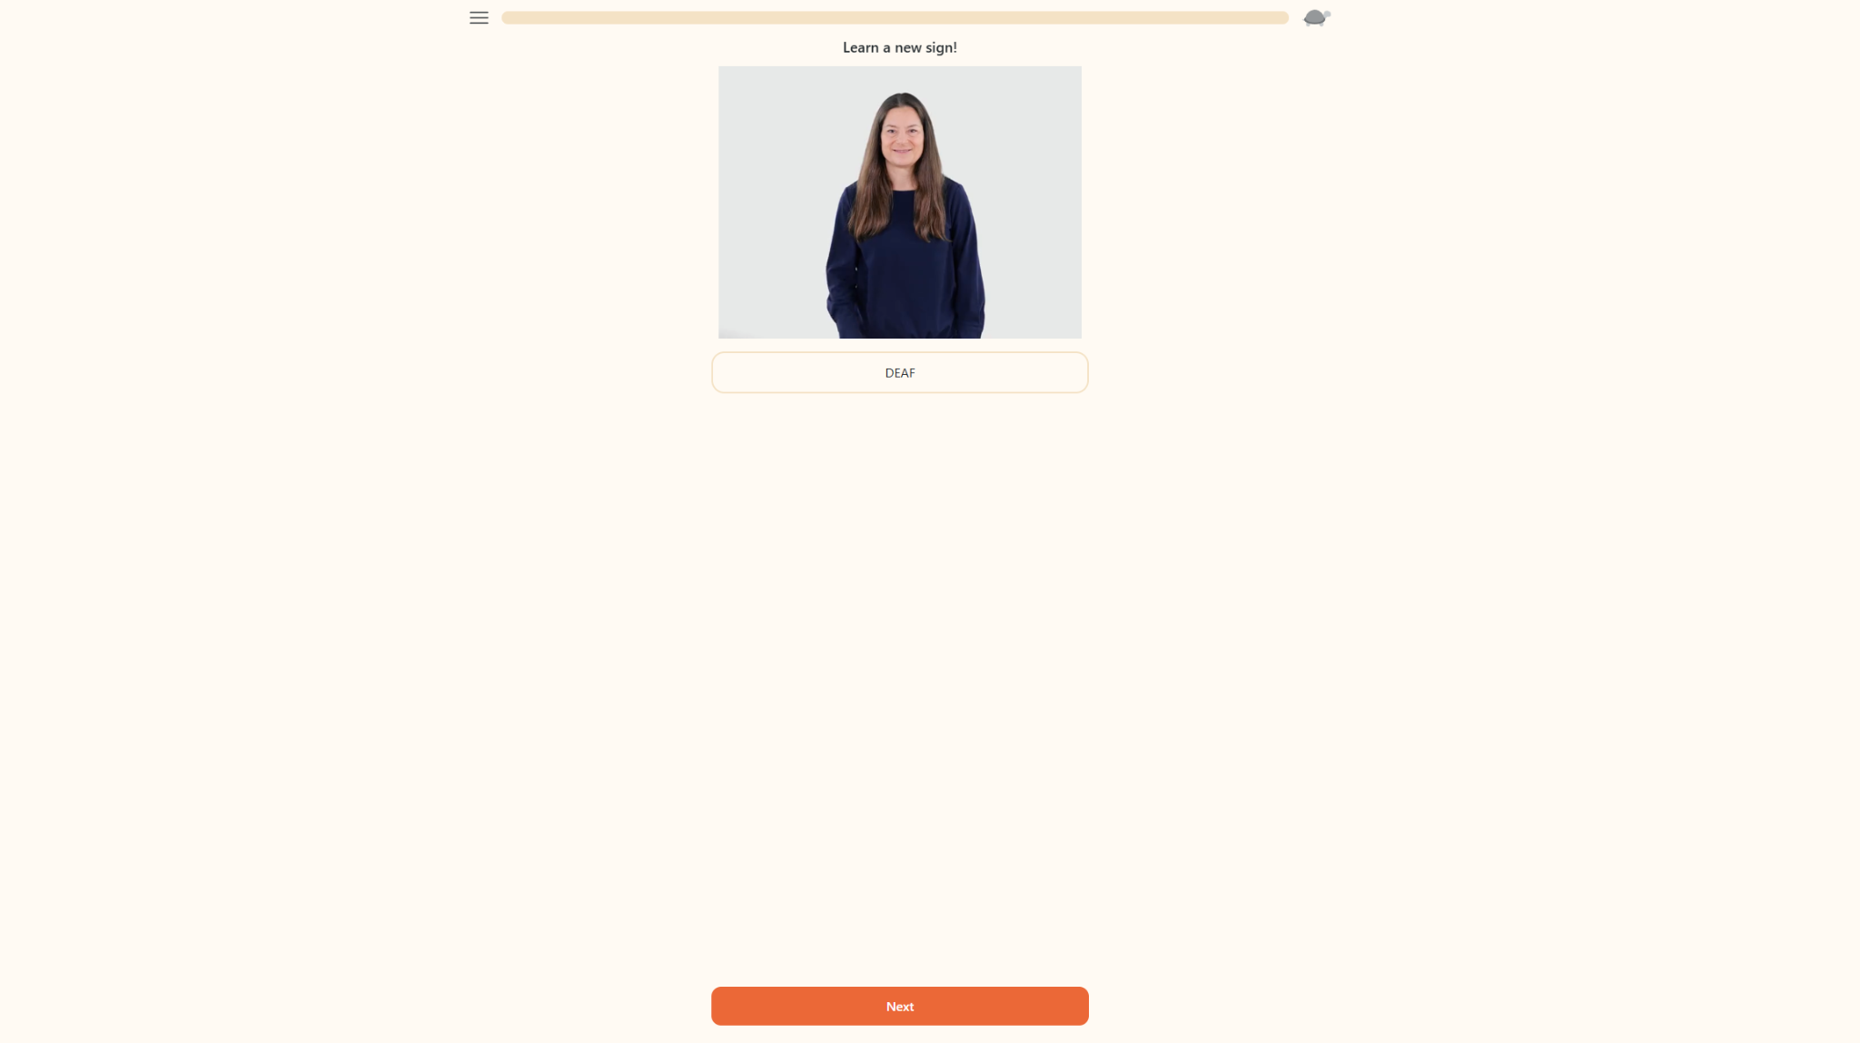
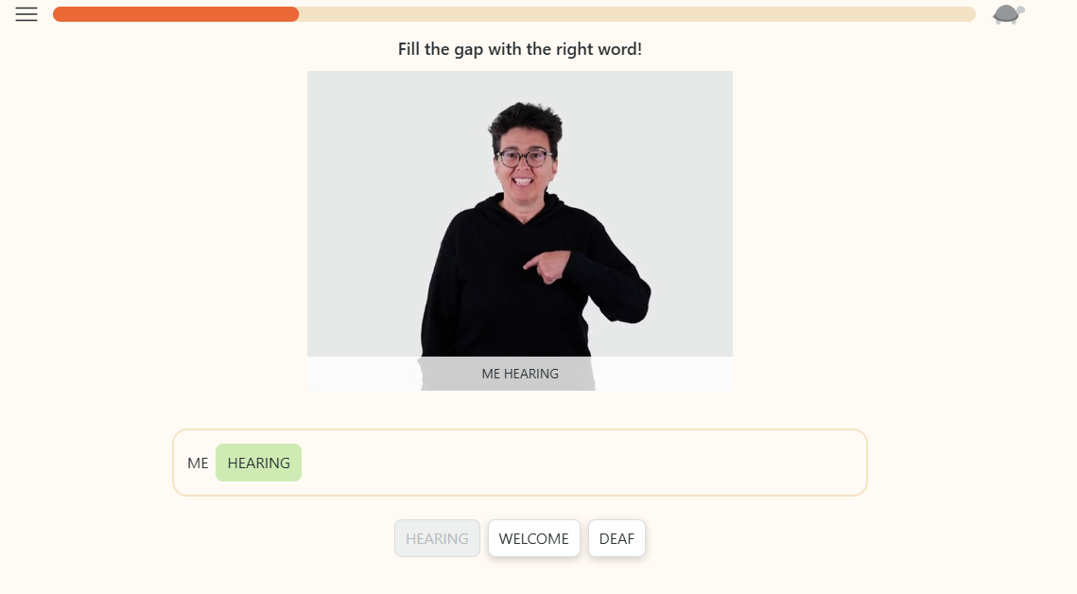
What Problems does Lingvano Have?
1
Minimal Progression
Repetitive
White Space

Slide 10
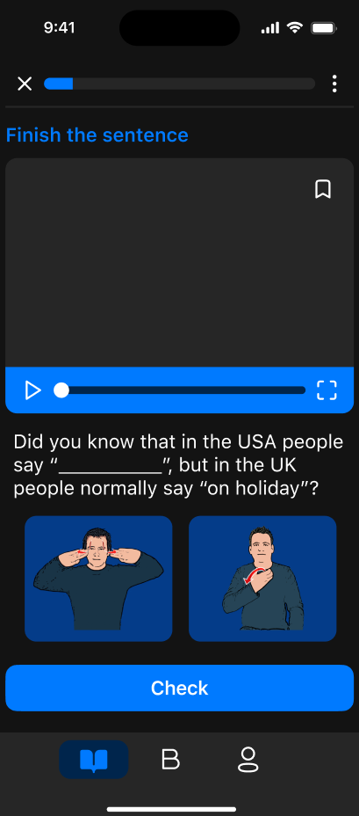
Improvements Within Signly
1
2
3
More than just memorization:
Signly allows you to truly learn words, provides quizzes, and encourages instructional learning by using common phrases, finishing sentences, and signing to the camera
Not just repetitive MC quizzes:
Signly also engages the user to type out sentences, match words, and sign themselves in order to learn
Design and Reinforcements:
Design is appealed to audience and systems such as Notifications and progress management allows users to gamify their learning

Slide 11
Figma
Prototype Link: Here

Slide 12
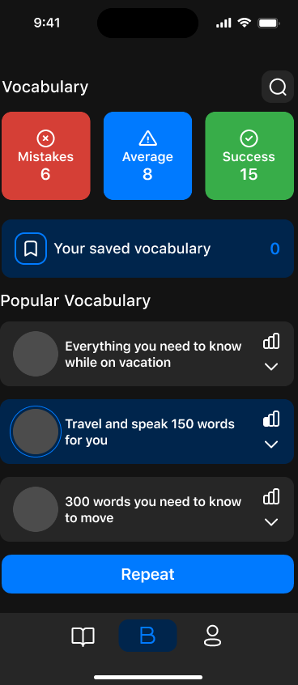
Thank You
Questions?

